Slide 1
Suicide Prevention, Intervention & Postvention in Schools
An overview

Slide 2
Suicide is a difficult topic…
Most of us have been touched, professionally and/or personally, by suicide Important to support one another as we approach this topic today….and in days following No scheduled breaks, come and go as is right for you

Slide 3
Context for the presentation
Build common understanding about suicide amongst staff
Highlight helpful prevention, intervention and postvention strategies
Provide recommendation actions for consideration at the system level

Slide 4
Child and youth suicide
Brief Overview

Slide 5
Suicidal behaviour
Non-Suicidal Self-Injury
a deliberate attempt to cause injury to one’s body without the conscious intent to die
Suicidal Ideation
Suicidal thoughts that include both contemplating death by suicide and planning actions that could result in death
Suicide Attempt
self-harming behaviour that includes an intention to die
Death by Suicide
self-harming behaviour that results in death

Slide 6
Facts and Figures
2nd leading cause of death after accidents, accounting for 17.3- 20.4% of adolescent mortality (but important to put this in context, death is relatively uncommon in this age group)
1.4% of all suicides occur in children under 14 years of age
Death by suicide is more prevalent in males than females aged 15-19
Recent Canadian epidemiological study shows overall stable rates of suicide over the past 30 years, but trends are changing: decreasing rates for males and increasing rates for females (Skinner & McFaull, 2012)

Slide 7
The complexity of Risk
Protective Factors
Vulnerabilities
(Distal)
Triggers
(Proximal)
Risk

Slide 8
Vulnerabilities - self
Mental illness (e.g., mood, anxiety, conduct disorders)
Past suicidal behavior
Substance use
Unstable mood, high impulsivity
Rigid thinking or coping patterns
Poor physical health / chronic illness
NOTE: These risk factors are correlational and not causal; typically it is a compounding of risk factors that is associated with suicidal behavior.
Notes:
Past suicidal behavior - 37% repetition rate
In more than half of suicidal attempters, there was failure at school or dropout

Slide 9
Vulnerabilities - home
Family history of suicides / attempts
Parental mental illness
Alcohol / substance abuse in the home
History of violence and/or abuse
Divorce, separation, other losses, death
Tension and aggression between parents
Parental lack of time; rejection; neglect
NOTE: These risk factors are correlational and not causal; typically it is a compounding of risk factors that is associated with suicidal behavior.
Notes:
Parental divorce rate = 2x higher in suicidal patients
40% of abused children show suicidal behavior

Slide 10
Vulnerabilities – school/community
Learning problems
Disengagement from school
Lack of connectedness
Marginalization
Discontinuity in identity (cultural, language, gender, sexual)
Some communities are at heightened vulnerability (e.g., aboriginal, LGBTQ, homeless)
Negative social relationships, including bullying

Slide 11
Bullying and Suicidal Behavior
Increases risk for bullying
Victimization
Pre-existing vulnerability
New or Exacerbated:
Anxiety
Depressed mood
Diminished self-worth
Feelings of entrapment
Loneliness
Withdrawal
Sleep/eating problems
Hopelessness
Suicidal ideation
Suicide attempt
Death by suicide
Which are risk factors for:
Adapted Lenny Berman 2010 Bullying and Suicide 8doc.webinar American Association of Suicidology

Slide 12
Triggers
Break up with boy/girl friend
Conflicts and increased arguments with parents and/or siblings
Loss of close friend
School related difficulties-conflicts with teachers, classmates
Difficulties with the law
Change in parents’ financial status
Serious illness or injury in family member
Real or perceived loss of status

Slide 13
Contagion
Occurs when suicidal behavior influences an increase in the suicidal behavior of others
Multiple suicidal behaviors/suicide deaths that occur within a geographical area or fall within an accelerated time frame may represent a potential cluster
Although clusters are rare, they are most common amongst adolescents

Slide 14
Circles of vulnerability
Geographical Proximity
Social Proximity
Psychological Proximity
Population at Risk
Lahad & Cohen, 2006

Slide 15
The role of cyber/social media
Increasingly there are sites, chat rooms and blogs that promote suicidal ideation
Methods of suicide are discussed on-line and some researchers have suggested that increases in particular methods in recent years may be related to this dialogue
The rapid spread of rumours and details of deaths by suicide is difficult to manage
Paradoxically, social media may hold potential benefits for suicide prevention
(Skinner & McFaull, 2012)

Slide 16
The role of media
Media can be helpful or harmful – it is never benign and they cannot view themselves as impartial observers
Contagion (mimicking of suicidal behavior) is a real phenomenon and youth are particularly vulnerable
Media needs to be held accountable for adhering to safe reporting guidelines following a death by suicide
Media can be helpful in bringing awareness to issues of child and youth mental health more broadly

Slide 17
Protective factors
Problem solving, life & communication skills
Sociability
Resilient Personality
A sense of belonging (school, community)
Secure attachment to positive parent/family
Access to other caring & supportive adults
Pro-social peers
Appropriate discipline, limit setting & structure
Opportunities to develop self-esteem
Good Mental Health

Slide 18
Youth suicide is complex and is often the result of many converging factors.
The explanations and the solutions are equally complex.

Slide 19
What can we do?
Reduce vulnerabilities - at school
Ensure school is safe and accepting, especially for vulnerable students (enhance sense of belonging, increase connectedness and engagement, show respect for differences)
Build on protective factors
Provide skill-building, opportunities to build esteem, etc.
Look out for triggers
Identify students at risk, listen
Minimize the risk for contagion
Have a plan for help

Slide 20
Suicide prevention, intervention, & postvention
Strategies for

Slide 21
First, do no harm
In considering various prevention, intervention, and postvention strategies, the Mental Health Leadership Team needs to understand that this area of work is not benign
Some actions are more effective than others, some are risky, and many have not been evaluated rigorously
This may mean taking a fresh look at existing practices to ensure alignment with the evidence base in this area
Close communication with your senior administration team will be important if practice changes are required

Slide 22
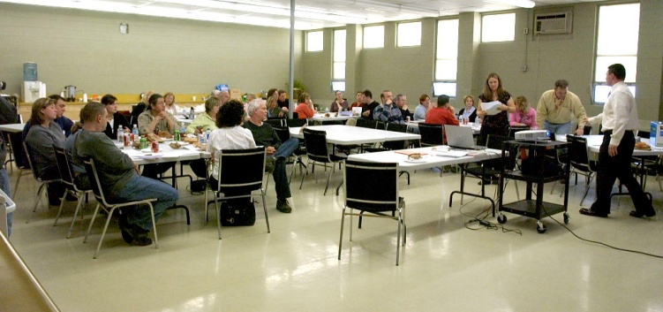
What is Suicide Prevention?
Efforts to reduce the risk of suicidal thoughts and behavior amongst students in a systematic way

Slide 23
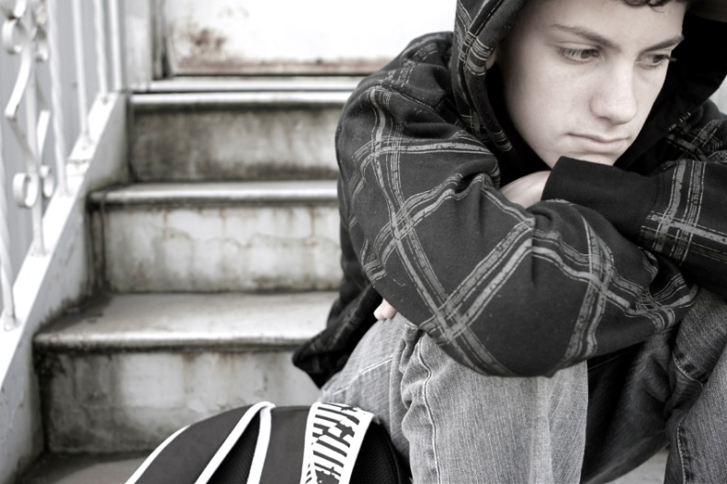
What is intervention?
Practices involved in recognizing and responding to students with suicidal ideation or behavior
Practices involved in supporting vulnerable students transitioning to and from mental health care

Slide 24
What is postvention?
Support for school communities in responding to suspected, attempted, or death by suicide

Slide 25
Helpful Prevention strategies
Safe and accepting school culture
Social emotional learning (coping skills, conflict resolution)
Early identification and treatment of mental health problems
Gatekeeper training
Information dissemination (staff, parents, students)

Slide 26
Prevention Strategies to avoid
There are risks inherent in the following strategies:
Suicide awareness curriculum with students, particularly if done in a single or stand alone lesson(s) (curriculum is best delivered in the context of instruction related to mental health more generally, over a period of several lessons, with a focus on protective factors…after adults have received gatekeeper training)
Assigning suicide as a central or sole focus of study
Large assemblies with guest speakers who talk about suicide
Events that have the potential to glorify/glamorize suicide
Peer counseling related to suicide

Slide 27
Prevention Strategy | Evidence
Early identification and treatment of mental health problems | Solid
School/community culture building | Solid
Adaptive coping skill development | Solid
Information dissemination / gatekeeper training | Promising
Screening and referral | Mixed
Youth engagement / peer helper programs | Mixed
Suicide awareness curricula for students | Mixed
Means restriction | Mixed
Crisis hotlines | Mixed
Media education programs | Insufficient Evidence
Effective postvention | Insufficient Evidence

Slide 28
Helpful intervention strategies
Identification and Referral
Ensure staff aware of warning signals
Ensure clear protocol at school level
Provide immediate and calm support to the student
Ensure safety and supervision
Facilitate assessment and care
Contact parent/guardian
Document actions

Slide 29
Helpful intervention strategies
Supporting Vulnerable Students
Ensure staff understand role and limits of competence
Support staff with caring adult role
Identify vulnerable students
Work with clinical staff, when involved
Create a school safety plan for each student, as needed
Implement and monitor plans, as needed

Slide 30
Intervention strategies to avoid
Peer intervention models with inadequate adult supervision and monitoring
Recruitment of gatekeepers who are uncomfortable / unready for the role
Counseling of high risk students by unqualified professionals

Slide 31
Helpful postvention strategies
Understand the phases of postvention
Have a plan for who does what at each phase of postvention
First 24 hours
Next 48-72 hours
During the first month
Planning for the future
Practice deliberate self- and team-care

Slide 32
Information for Parents/Guardians and the wider school community
Information for All Staff, with Support for Vulnerable Members
Support for Vulnerable Students
Support for Students in Crisis and their Families
Information for All Students, with support as needed
Information for All Schools in board, with support for vulnerable schools
Social Media
Media

Slide 33
Documentation of Ontario community mobilization response following a suicide cluster

Slide 34
A Comprehensive suicide prevention strategy includes:
Proactive, universal strategies that promote a sense of belonging at school (reaching out to vulnerable students)
Wide-spread instruction in adaptive coping skills, like problem solving and conflict resolution
Knowledge and skills for early identification of mental health problems (with clear connections to service)
Gatekeeper training, with protocols for students at risk
Effective postvention, with protocols
Other strategies? Evaluate!!

Slide 35
Suicidal behavior is a reality in your schools Be proactive, Be Prepared

Slide 36
Identify Teams*
Board
Suicide Strategy Team – protocol development, strategy selection, etc.
Suicide Response Team – support school team, work with media, etc.
School
Suicide Strategy Team – protocol development, strategy selection
Suicide Response Team – support students, staff, community, etc.
Crisis Response Team
Support staff and students in need of immediate support individually or in small groups
* These may be existing leadership teams at the board and school level, or subgroups within these

Slide 37
Clarify roles
Leadership and Planning Teams
Who will be involved in protocol development, strategy selection, training, communication, etc.?
Response Teams
Who will support the school and the school team during the crisis? Following the crisis? Who does what? For example,
Who will contact the family, communicate with staff, students, etc.
Who will support the school response team?
Who will work with media?
Who will work with community?
Who will link with mental health partners?

Slide 38
Select and implement prevention strategies
If you have a mental health strategy that includes universal promotion and skill-building, you are already doing some of this work
Work with caring and accepting schools professionals to enhance sense of belonging in schools
Prepare information for dissemination with key groups
Work towards mobilization of community

Slide 39
Sources, with Thanks
MH Leader Suicide Subgroup
Ian Manion, Ontario Centre of Excellence for Child and Youth Mental Health
Ian Brown, School Mental Health ASSIST
Stephan Roggenbaum & Katherine Lazear, University of South Florida
Key Resources:
SAMHSA Toolkit, Suicide Postvention Guidelines South Australia, Principal Leadership 2009, NASP Postvention Strategies for School Personnel, Kutcher 2008

